Slide 1

Disease diagnosis using machine learning
Group members with Student Id
Om Panchal - 22106025
Aashuthosh Pandey – 22106121
Ayush Gupta - 22106074
Project Guide
Prof. Poonam Tiware

Slide 2
Outline
Introduction
Literature Survey of the Existing Systems
Problem Statement
Limitations of the Existing Systems
Framework/Algorithm
Implementation
Conclusion
References

Slide 3
Introduction to Disease Diagnosis Using Machine Learning
In today's rapidly evolving healthcare landscape, the integration of technology, particularly machine learning (ML), has revolutionized the way we approach disease diagnosis.
Our web application is designed to harness the power of ML to assist in the early detection and diagnosis of diseases based on the symptoms provided by users.
By analyzing symptoms, our model can predict the most likely disease and provide dietary recommendations tailored to the predicted condition.

Slide 4
Literature Survey of the existing system
Author Name | Publisher Name | Year | Information
Lippi et al | Machine Learning in Healthcare | 2023 | In recent years, Lippi et al. (2023) conducted an extensive study on the application of machine learning models, specifically Support Vector Machines (SVMs) and Random Forest algorithms, for disease diagnosis. Their research highlighted the ability of these algorithms to process large, multidimensional datasets, including patient history, lab results, and imaging data.

Slide 5
Literature Survey of the existing system
Author Name | Publisher Name | Year | Information
Wei Zhang | Journal of Biomedical Informatics | 2023 | Wei Zhang, explored the use of deep learning techniques in diagnosing neurological diseases. Their study specifically focused on convolutional neural networks (CNNs) and their ability to analyze MRI scans and other imaging data. The research demonstrated that CNN models could outperform traditional diagnostic methods

Slide 6
Literature Survey of the existing system
Author Name | Publisher Name | Year | Information
Rajesh Gupta | Artificial Intelligence in Medicine | 2021 | Rajesh Gupta, (2021) conducted a comprehensive study on the application of ensemble learning methods in diagnosing cardiovascular diseases. The study compared the performance of various machine learning algorithms, including Gradient Boosting Machines (GBM) and XGBoost, on clinical datasets.

Slide 7
Problem Statement
Accurate and timely diagnosis of diseases remains one of the most critical challenges in healthcare. Traditional diagnostic methods often rely heavily on subjective assessments, extensive lab testing, or costly imaging techniques, which can delay diagnosis and treatment. With the increasing availability of large, multidimensional medical datasets—ranging from patient histories to imaging and genetic information—there is a growing need for automated systems capable of processing this data efficiently to assist healthcare professionals in making faster and more accurate diagnoses.

Slide 8
Limitations of Existing Systems
Complexity in Data Handling:
Lippi et al. emphasized that cancer detection models require processing large, multidimensional datasets, including patient history, lab results, and imaging data. This high-dimensional data can sometimes lead to overfitting, where models perform well on training data but poorly in real-world applications.
Data Imbalance:
Both cancer and diabetes datasets often have an imbalance in class distributions (e.g., more healthy patients than those with diseases). SVMs and Random Forests are sensitive to class imbalances, leading to biased predictions toward the majority class.
Limited Availability of High-Quality Data:
While Jha et al. used longitudinal patient data to predict diabetes, such comprehensive datasets are not always available or complete. Missing or Inaccurate data can negatively affect model performance and limit its applicability to broader populations.
Limited Explainability:
In the case of Jha et al.’s work on diabetes prediction, while machine learning models accurately predicted the onset of diabetes, they did not always provide insight into the most critical risk factors, making it harder to personalize prevention strategies.

Slide 9
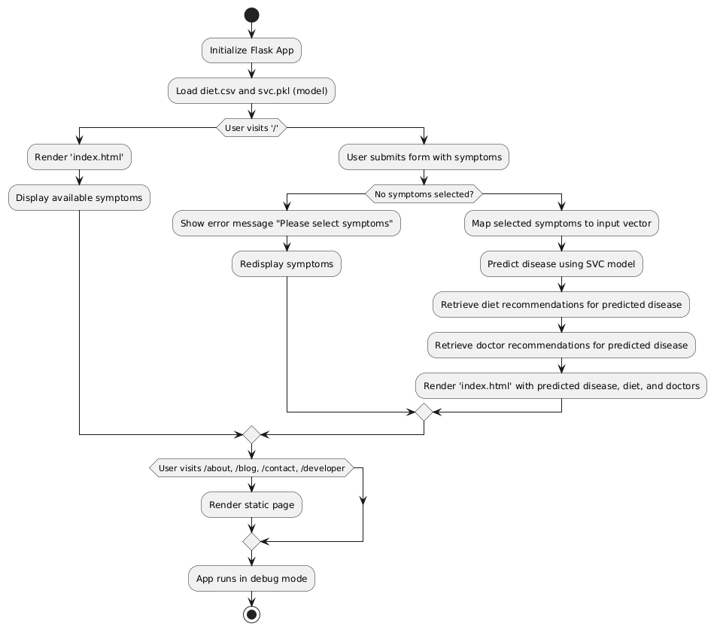
Framework and Algorithm

Slide 10
Technology used
Programming Language: Python
Web Framework: Flask
Libraries: Pandas, NumPy
Frontend: HTML,CSS
Datasets : diets.csv

Slide 11
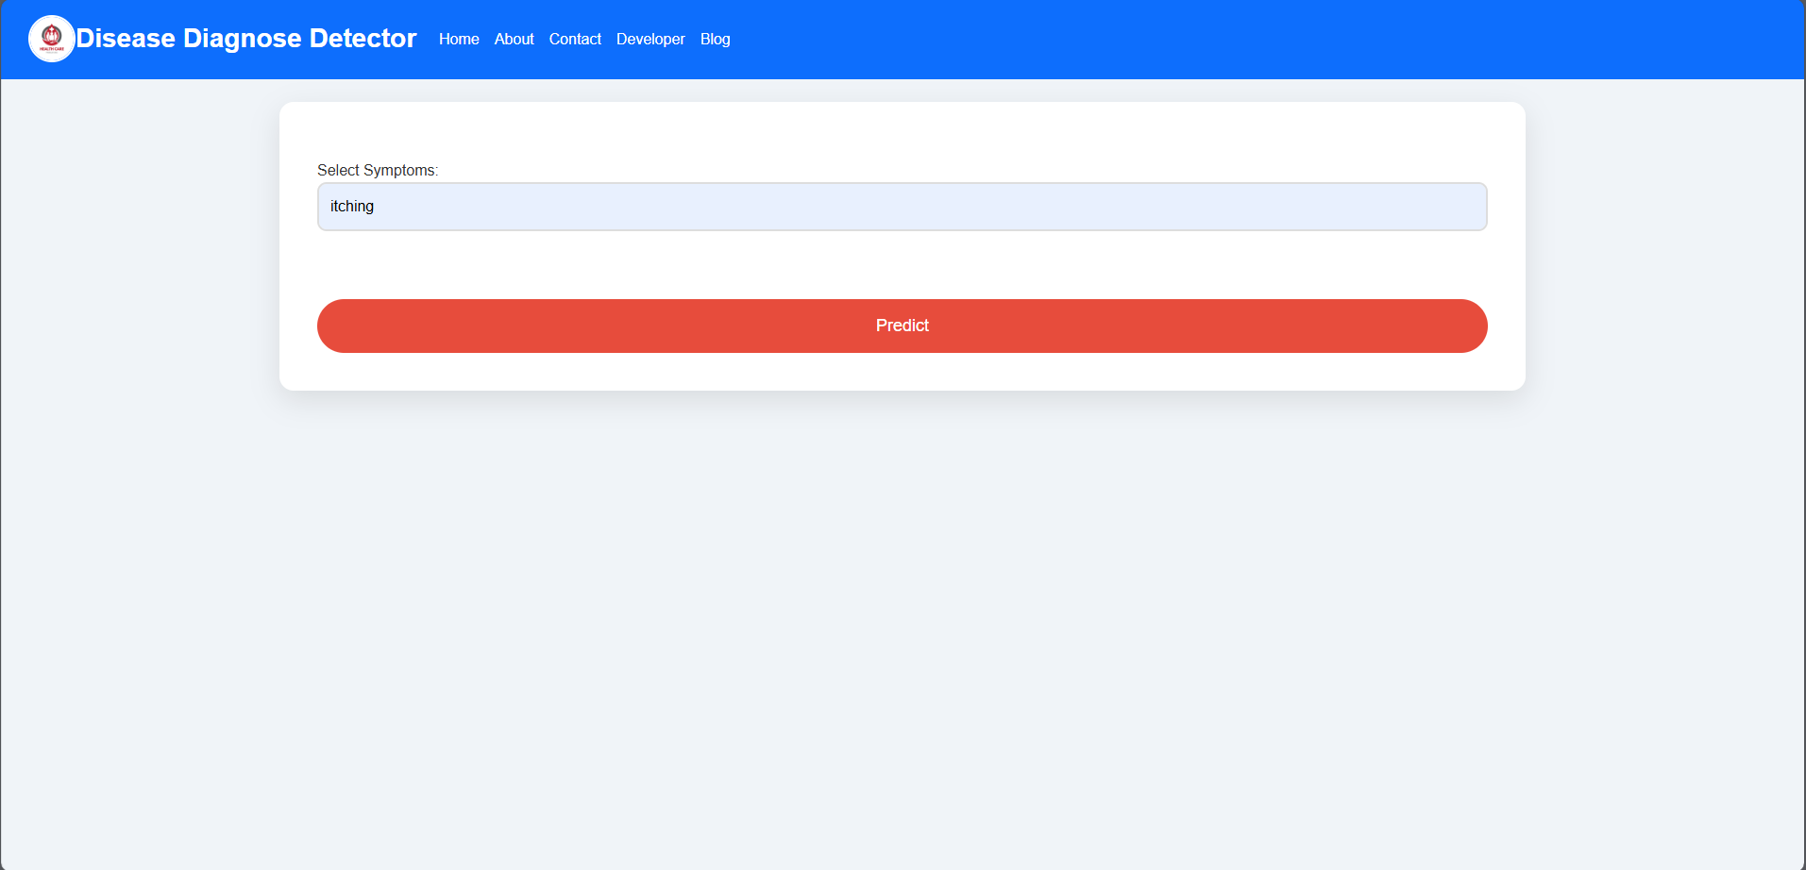
Implementation

Slide 12
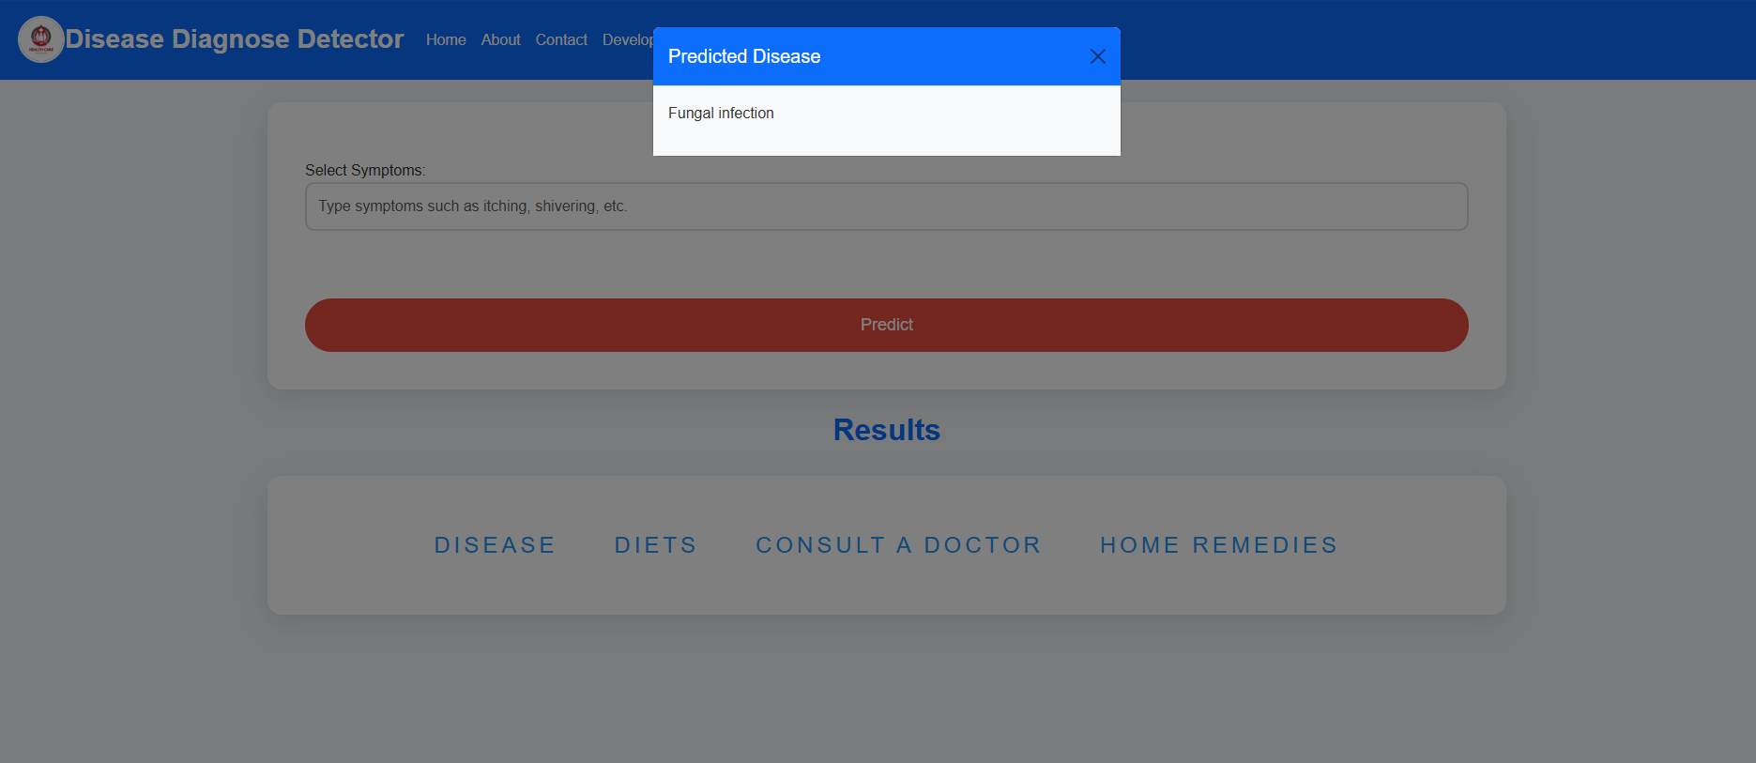

Slide 13
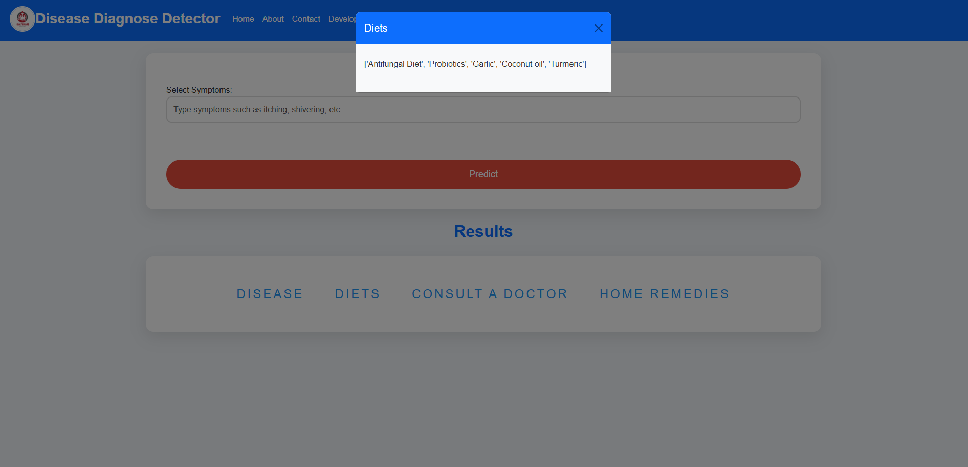

Slide 14
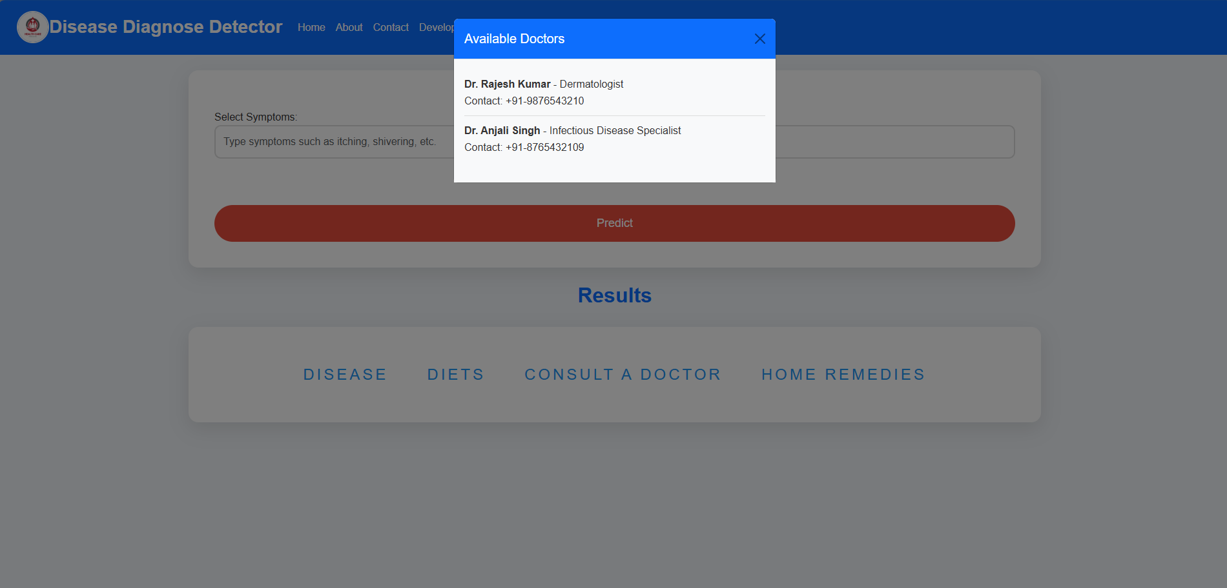

Slide 15
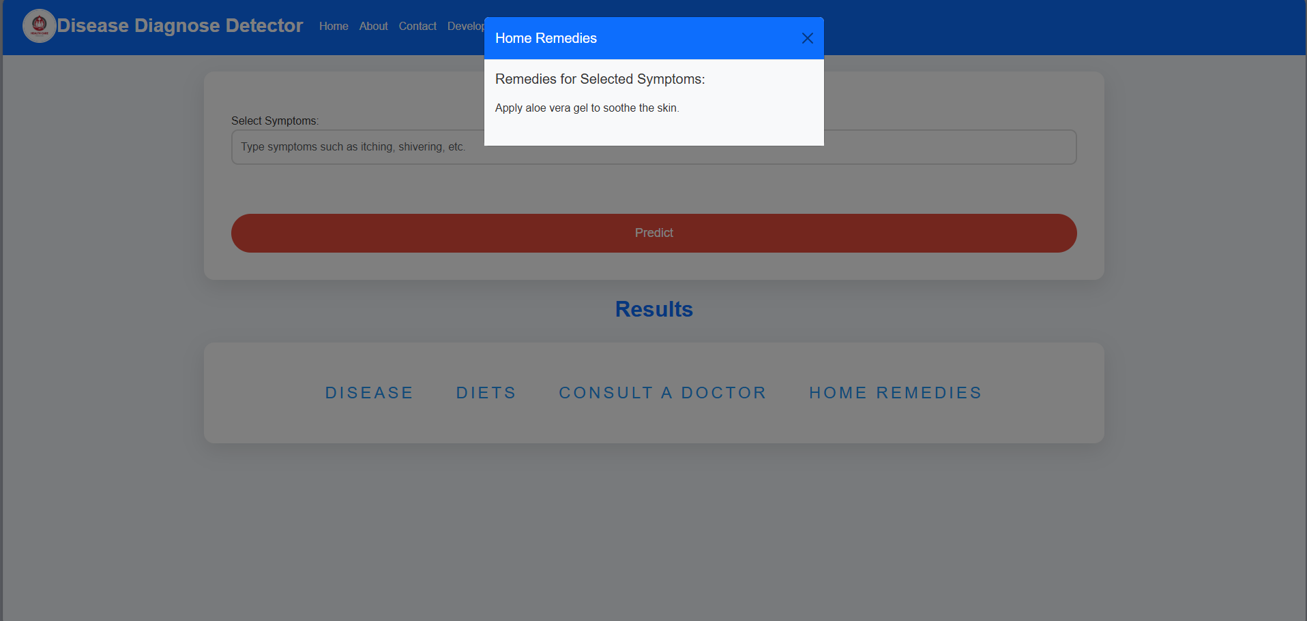

Slide 16
Conclusion:
In this implementation, we have developed a web-based application using Flask to provide disease predictions and dietary recommendations based on user-reported symptoms.
The application integrates a pre-trained Support Vector Classifier (SVC) model, which predicts diseases by analyzing symptom data converted into a numerical format.
By leveraging the diets.csv file, the system retrieves and presents tailored dietary recommendations corresponding to the predicted disease.
This solution not only aids in disease diagnosis but also offers actionable dietary guidance to support better health management.

Slide 17
References
[1] Lippi, G., Plebani, M., & Favaloro, E. J. (2018):
Support Vector Machines for disease diagnosis: Applications in cancer and cardiovascular conditions. Journal of Clinical Pathology, 71(10), 829-836. https://doi.org/10.1136/jclinpath-2018-205026
[2] Rajkomar, A., Oren, E., Chen, K., & Dai, A. M. (2019):
Scalable and accurate deep learning with electronic health records. npj Digital Medicine, 2(1), 1-10. https://doi.org/10.1038/s41746-019-0172-7
[3] Yao, C., Fang, X., & Zhao, W. (2021):
Machine learning-based dietary interventions for chronic disease management. Nutrients, 13(6), 2049. https://doi.org/10.3390/nu13062049
[4] Jha, D., Topol, E. J., & Steinhubl, S. R. (2020):
Enhancing disease prediction and management with longitudinal data using machine learning techniques. Journal of the American Medical Association, 324(7), 705-706. https://doi.org/10.1001/jama.2020.1675
[5] Heshmat, R., Hosseini-Esfahani, F., Bahrami, A., & Kelishadi, R. (2018): Personalized dietary recommendations using machine learning for managing chronic diseases. Diabetes, Metabolic Syndrome and Obesity: Targets and Therapy, 11, 365-374. https://doi.org/10.2147/DMSO.S161532

Slide 18
Thank You...!!

